Slide 1

WASTE MANAGEMENT USING IOT
PESIT-- BSC
DEPARTMENT OF ELECTRONICS AND COMMUNICATION & ENGINEERING
Notes:
1
12/04/17

Slide 2
Outline
Introduction
Literature Survey
Aim of Project
Objectives
Design
References
Notes:
2
12/04/17

Slide 3
Introduction
The Board has constituted State Level Municipal Solid Waste Authorization Committee to verify the site selection criteria and to issue authorizations under Municipal Solid Waste Rules, 2000 in respect of City Corporations and Bruhat Bangalore Mahanagara Palike .
Solid waste is the unwanted or useless solid materials generated from combined residential, industrial and commercial activities in a given area.
Management of solid waste reduces or eliminates adverse impacts on the environment and human health and supports economic development and improved quality of life.
These include monitoring, collection, transport, processing, recycling and disposal.

Slide 4
Literature Survey
LANDFILL
Gases released from municipal waste landfills have the potential to cause odors in neighborhoods surrounding the landfill.
Less odorous gases can also be generated at landfills due to chemical reactions and due to the evaporation of chemicals put into the landfill.
Methane and carbon dioxide are the major gases produced by the bacterial decay of landfill wastes(USEPA, 1991). Methane present underground is flammable, but it is not associated with odors or hazards once emitted into the air[1].

Slide 5
Literature Survey(contd..)
GREENHOUSE GAS EMISSION
The GHG emission fluxes showed wide variations within each site and between the KDG and PGD dumping grounds
quantity of GHG generated, oxidation of methane in upper crust of landfill and net emission to the atmosphere are all the other factors contributing to the uncertainties in GHG emission estimation from landfills.
The ratio of total CH 4 emitted since the time of opening of the landfill to the amount of MSW dumped gives the emission factor (EF) as Gg CH 4 per Gg waste [2].

Slide 6
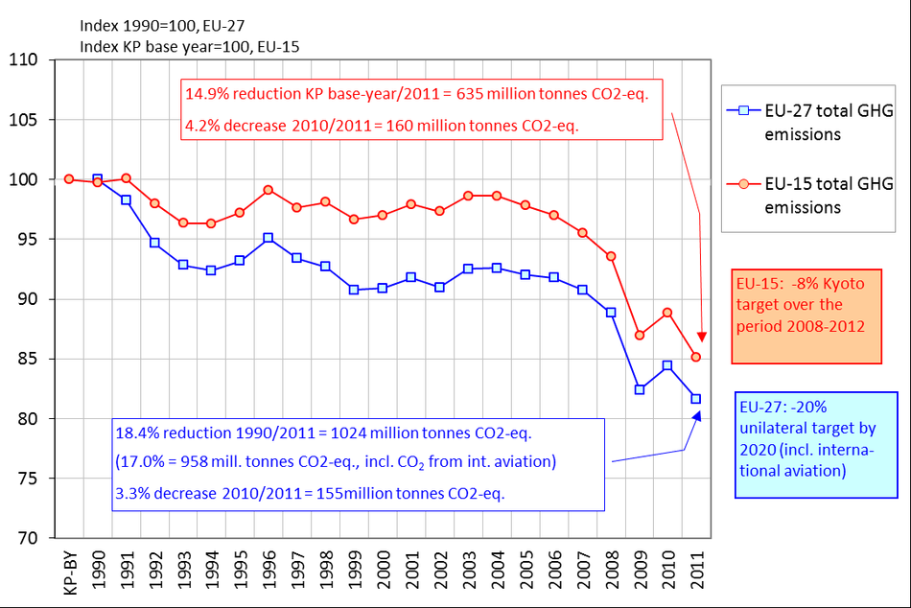
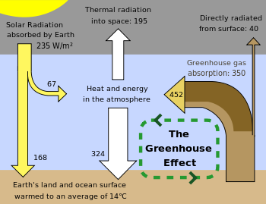
Literature survey(contd...)

Slide 7
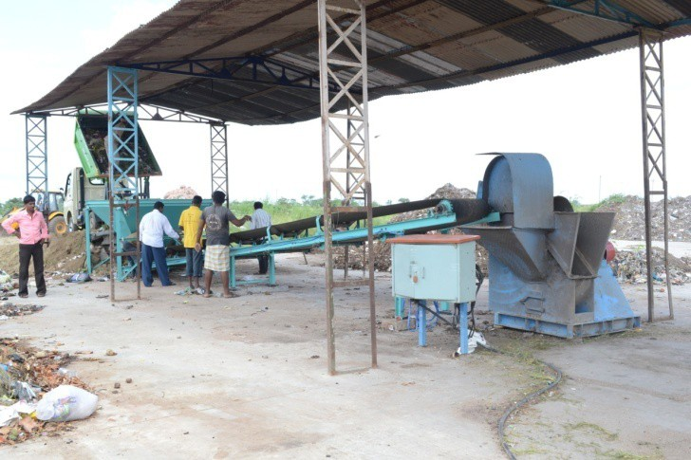
Literature survey(contd..)
MSW
As per the annual report submitted by the local bodies including the BBMP for the year upto 2013/2014, the Karnataka State generates about 8784 Tonnes/Day of which
(a) BBMP generates 3500 T/D and collects 3000T/D (85%)
(b) Other 218 local bodies generates 5284 T/D and collects 4602T/D (87%)

Slide 8
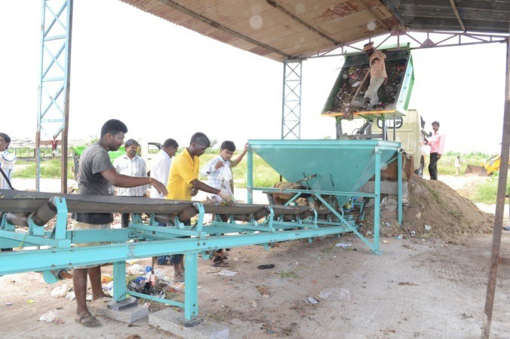
Literature survey(contd..)
PROCESS INVOLVED IN WASTE MANAGEMENT :-
SITE SELECTION
SEGREGATION
STORAGE OF WASTE
TRANSPORTATION
PROCESSING OF WASTE
DISPOSAL OF WASTE

Slide 9
Literature survey(contd..)
The following Urban Local Bodies do not have their
own Landfill site or processing site:
1. Devanahalli TMC
2. Vijayapura TMC
3. Anekal TMC
4. Yelandur TP
5. Bantwal TMC
6. Mudabidiri TMC
7. Ullal TMC
8. Saligrama TP

Slide 10
ACTION TAKEN BY THE BOARD TO IMPLEMENT THE MSW RULES
The Karnataka State Pollution Control Board has invoked and issued the Directions to all the Deputy Commissioners.
In response to the said Directions, the Deputy Commissioner, BBMP have furnished TIME BOUND ACTION PLANS.
Land fill without processing is being done only at Bingipura and Laxmipura facilities. To achieve100%processing of waste, Government has sanctioned setting up of six new facilities. These are being set up at the following locations:
1) Kanahalli - 500 TPD
2) Seegihalli - 200 TPD
3) Doddabidarakallu - 200 TPD
4) Lingaderenahalli - 200 TPD
5) Subrayanpalya - 200 TPD
6) Chikkanagamangala - 500 TPD

Slide 11
Literature survey(contd..)
On this basis, at present number of local bodies in the state of Karnataka
are as follows:
Bruhat Bangalore Mahanagara Palike | 01
City Corporations | 10
City Municipal Councils | 41
Town Municipal Councils | 68
Town Panchayats | 94
Notified Area Comittee | 05
Total | 219

Slide 12
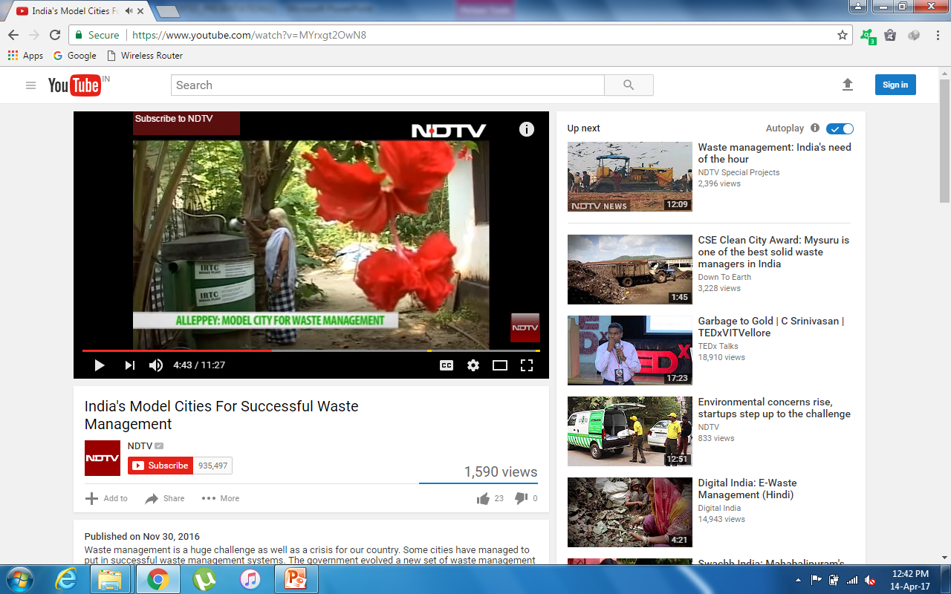
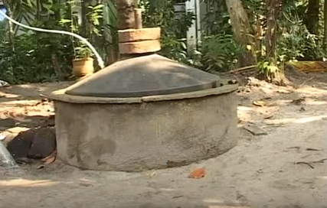
MODEL CITIES FOR SUCCESSFUL L WASTE MANAGEMENT
ALLEPPEY in KERLA is one among
the successful city.
This city is called as ZERO WASTE CITY .
In this city ,has a bio gas plants installed
in front of their homes .
This conerts household waste to biogas
(energy) .
Biogas is used in production of electricity, bio LPG gas to cook and many application.
Here alternate ways are also used
like segregattion of waste.
Seperating wet and dry waste ,where
dry waste are collected in open field
area.
Wet waste in bio gas plants to covert
the waste to energy.

Slide 13
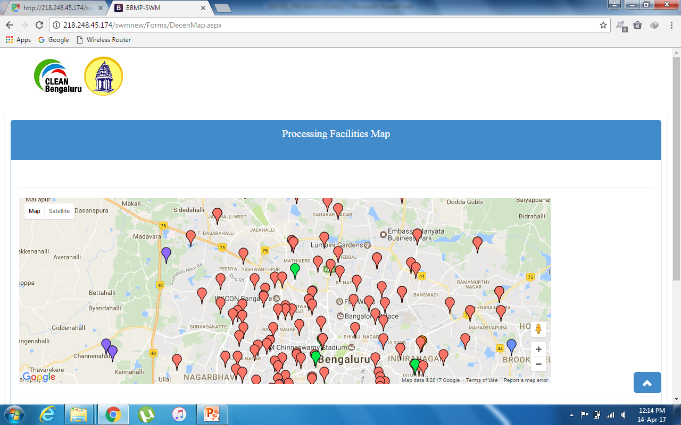
PROCESS FACILITIES MAP

Slide 14
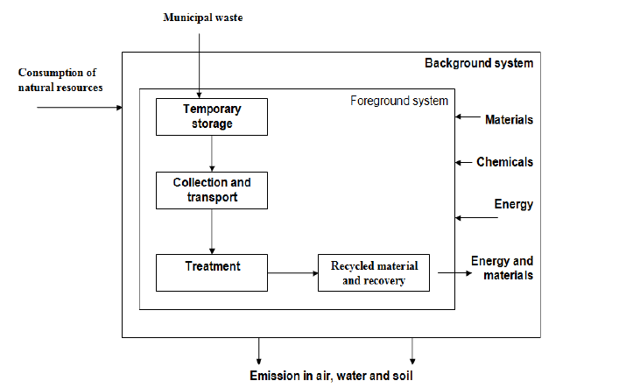
Aim of the Project
To develop framework for Analysis of muncipal waste management and landfills based on garbage collection centers.
.

Slide 15
Objectives
Facilities at the site.
Specification for landfilling/pollution prevention.
Water quality monitoring /ambient air quality monitoring.
The Annual Report is prepared based on reports submitted
by the local bodies in FormII duly signed by concerned
Chief Officer/Commissioners of BBMP.

Slide 16
Methodologies
Methodology for Objective-1:
Understand the existing techniques available for analysis of municipal waste data by studying articles,survey reports and literature review.
Methodology for Objective-2:
Collecting the online data sets available from the website.
Check the collected data and compare with the standard values.

Slide 17
Methodologies(contd..)
Methodology for Objective-3:
The municipal waste data stored in server is analysed and predicted the garbage collection performance using related models.
Methodology for objective-4:
Based on the predictions obtained, the appropriate reports are generated.
The obtained results are depicted graphically.

Slide 18
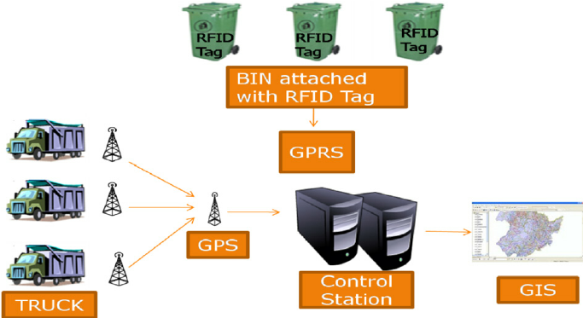
Design

Slide 19
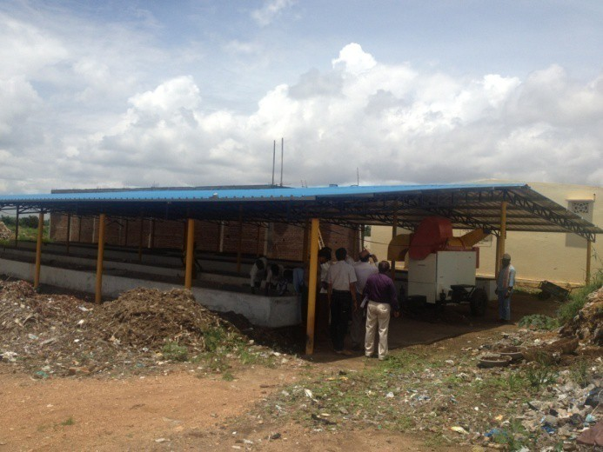
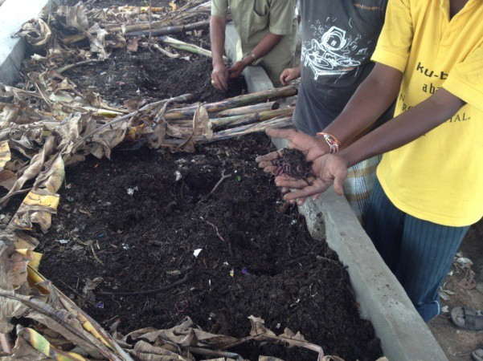
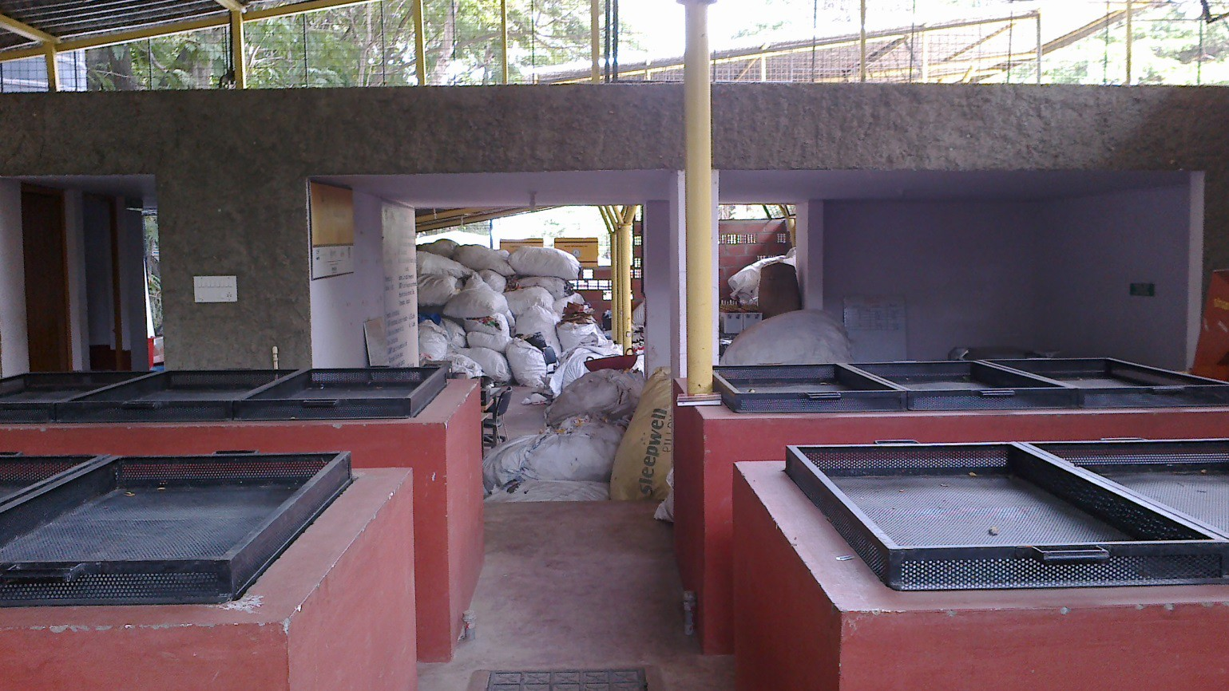
Waste vermicomposted at Sira, TMC
12/04/17
19
Vermicomposting and Dry Waste collection Center at Koramangala Ward at BBMP,
Bengaluru

Slide 20
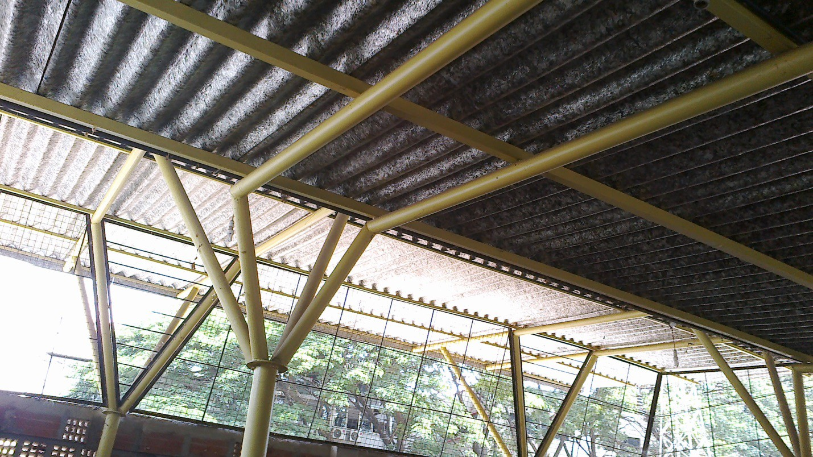
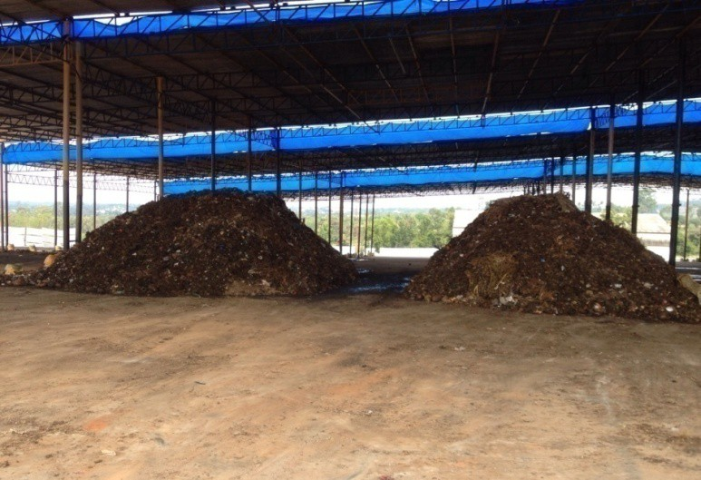
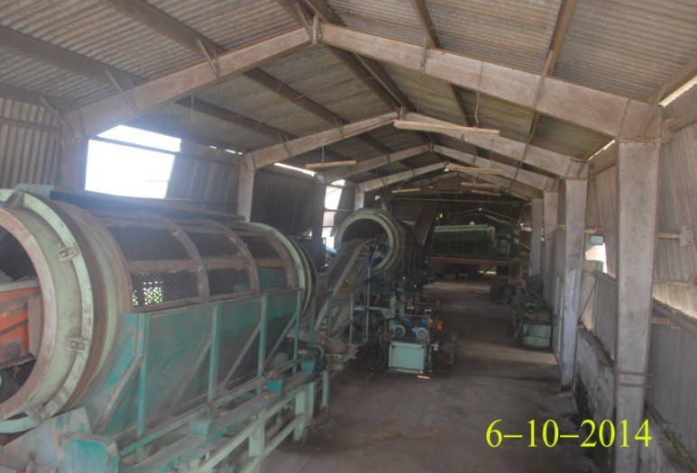
Roof top manufactured from Tetrapack waste covers-Koramangala Ward at BBMP,
Bengaluru
Mavallipura Unit, Bengaluru (New proposal to compost the organic waste, all inert
waste taken away to Landfill site)

Slide 21
References
[1] CTDPH (1996) Health Consultation: Hartford Landfill, Review of Air Emissions Data. Jappinen, P., et al. (1990) Exposure to hydrogen sulfphide and respiratory function.British Journal of Industrial Medicine, pgs. 824-828.
[2]Greenhouse gas emissions from municipal solid waste management...,Chemosphere(2007),doi:10.1016/j.chemosphere.2007.10.024

Slide 22
THANK YOU

Slide 25


